Slide 1
Linear Discriminator

Slide 2
Linear Discriminantor
Linear Discriminant Analysis (LDA) also known as Normal Discriminant Analysis is supervised classification problem that helps separate two or more classes by converting higher-dimensional data space into a lower-dimensional space.
It is used to identify a linear combination of features that best separates classes within a dataset.

Slide 3
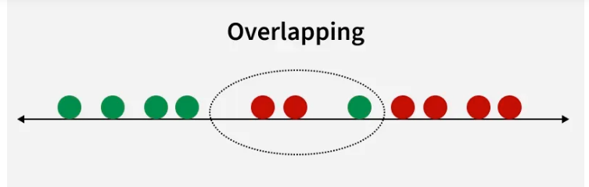
Without LDA

Slide 4
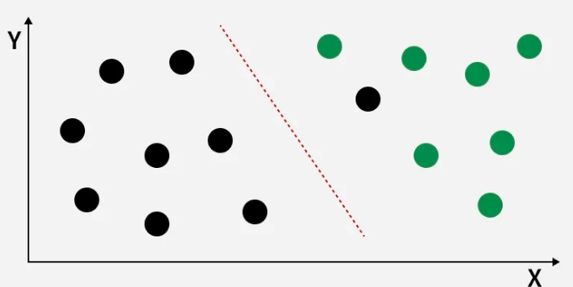
With LDA

Slide 5
Linear Discriminant Analysis (LDA) is a supervised learning technique used for classification tasks. It helps distinguish between different classes by projecting data points onto a lower-dimensional space, maximizing the separation between those classes. LDA performs two key roles:
Classification: It finds a linear combination of features that best separates multiple classes.
Dimensionality Reduction: It reduces the number of input features while preserving the information necessary for classification.

Slide 6
Properties and Assumptions of LDA
Gaussian Distribution: LDA assumes that the features within each class follow a normal (Gaussian) distribution.
Equal Covariance Matrices: It assumes that the variance (or spread) of data points is the same across all classes.
Linearity: The relationship between the features and the target variable is assumed to be linear.
Independence: The features used should ideally be independent of each other.

Slide 7
Working of LDA
Key Concepts:
Maximizing Between-Class Variance: LDA maximizes the separation between the means of different classes.
Minimizing Within-Class Variance: It minimizes the spread (variance) within each class, ensuring that data points from the same class remain close together.
Projection to Lower-Dimensional Space: LDA projects data onto a new axis or subspace that best separates the classes. For example, in a 3-class problem, LDA can reduce the dimensionality to 2 or even 1 while preserving class-related information.

Slide 8
Working Mechanism:
Step 1: Compute the mean vectors for each class.
Step 2: Calculate the within-class and between-class scatter matrices.
Step 3: Solve for the linear discriminants that maximize the ratio of between-class variance to within-class variance.
Step 4: Project the data onto the new lower-dimensional space.

Slide 9
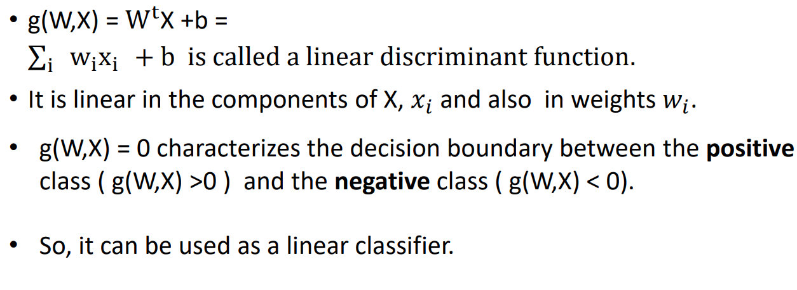
Mathematical equation

Slide 10
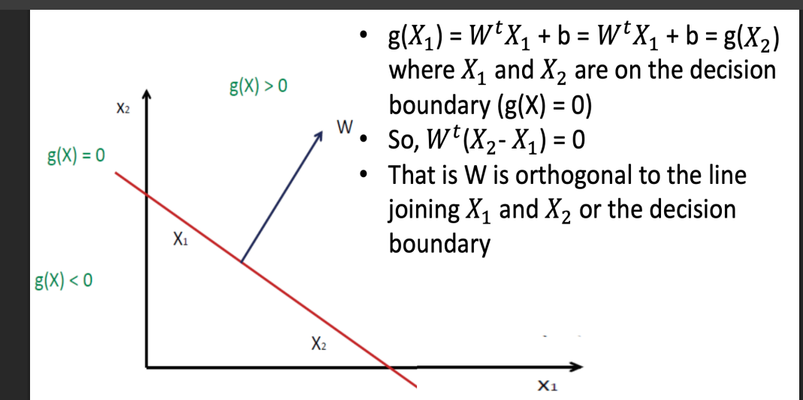

Slide 11
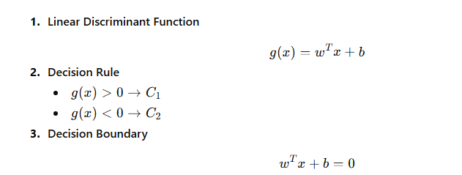

Slide 12
